Slide 1
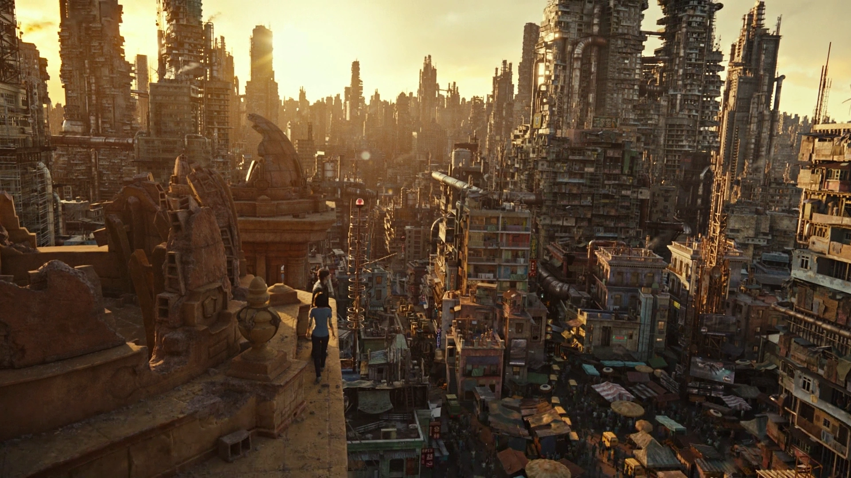
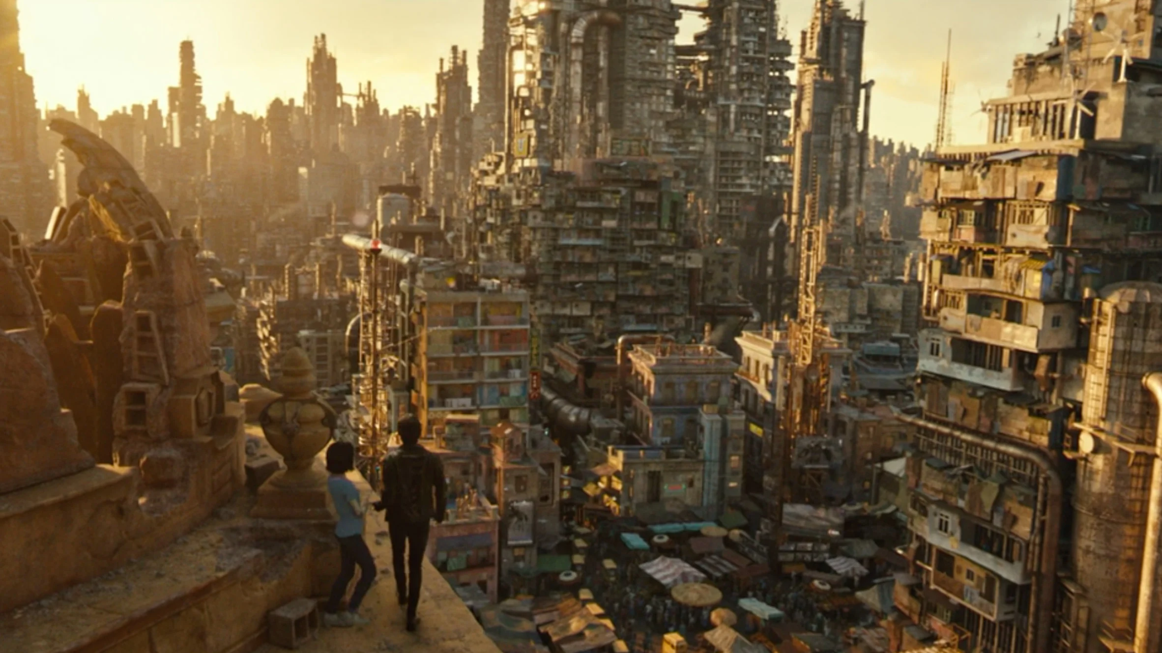
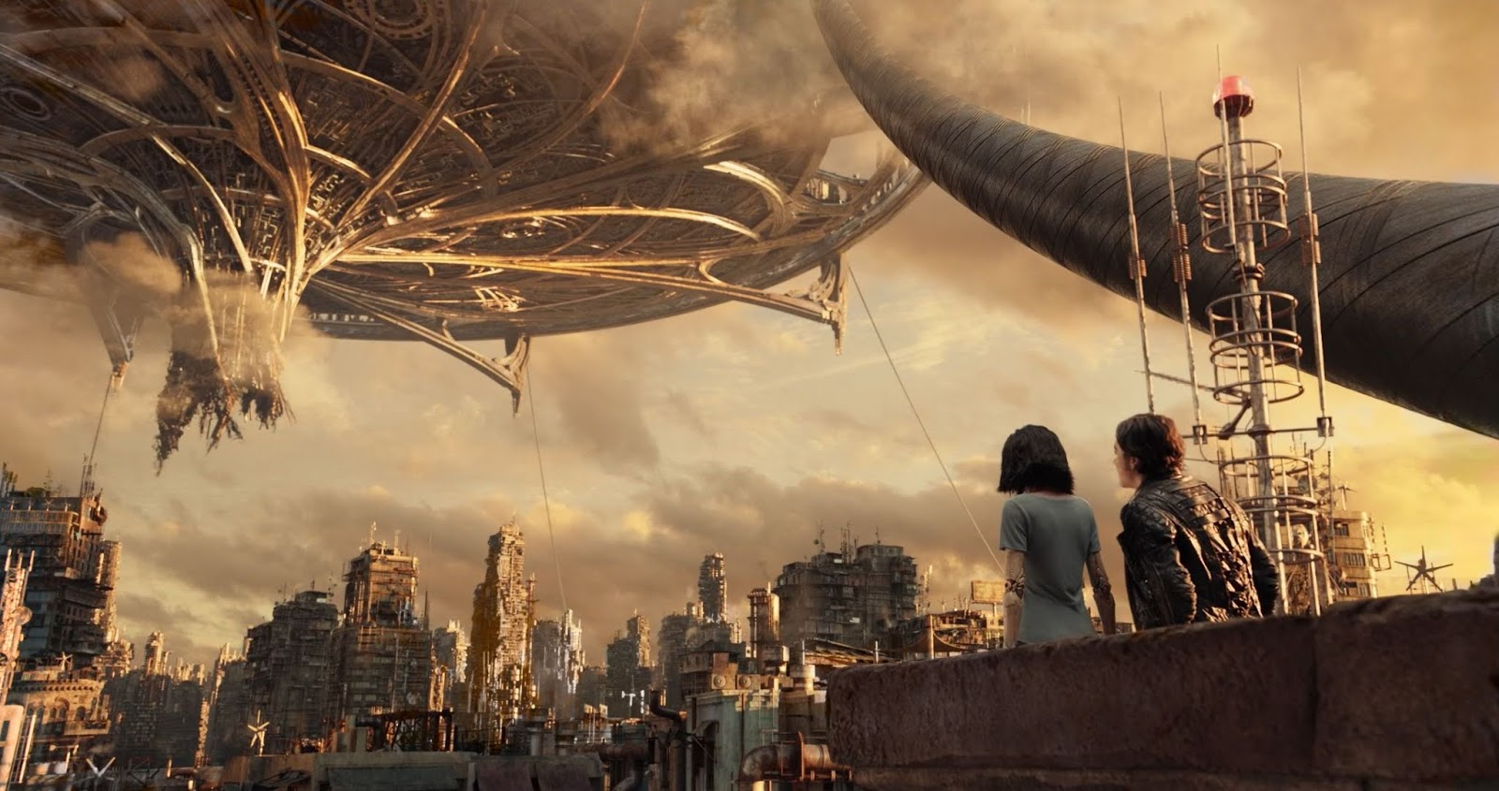
ALITA : BATTLE ANGEL
The Earth in 2563
Following a major war, the Earth is transformed into a rubbish dump. In a megalopolis that looks like a refugee camp, a cyborg repairman gives new life to a young girl whose mechanical body has been destroyed. Alita becomes a vigilante ready to fight a mysterious tyrant.
This movie, adapted from a manga, depicts a nightmarish city called Iron City, where the line between life and machine becomes increasingly blurred. We are plunged into a post-apocalyptic world where enormous futuristic buildings conceal misery and violence. People are struggling to survive. Everyone is trying to reach Zalem, a floating city, compared to paradise, where poverty and violence do not exist. The dystopian elements are evident in the striking contrast between the opulence of Zalem and the struggles faced by the residents of Iron City, as well as the cyborg-enhanced combat sports that serve as entertainment for the privileged.

Slide 2
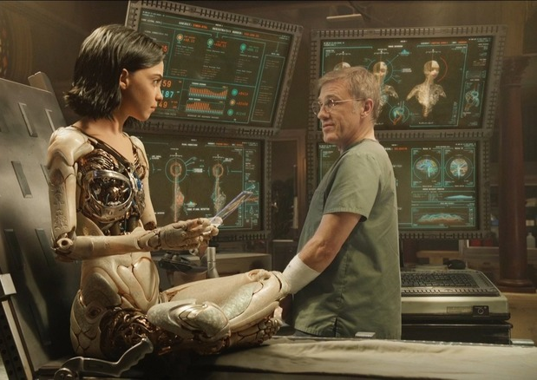
The dystopia is served up by a charismatic heroine who stands up to what is wrong and looks for ways to do something about it. We follow her as she searches for a glimmer of hope in a world in perdition. This movie depicts a horrible world that derives from ours but is worse. It is bad and oppressive, and people want to escape. Trust does not exist anymore. It enhances the worst of our society and human people’s behaviours: a drift of our society. The topics of societal inequality, technological advancements and the loss of humanity are central to the film's narrative, which is why, it is often associated with the dystopian genre.

