Slide 1
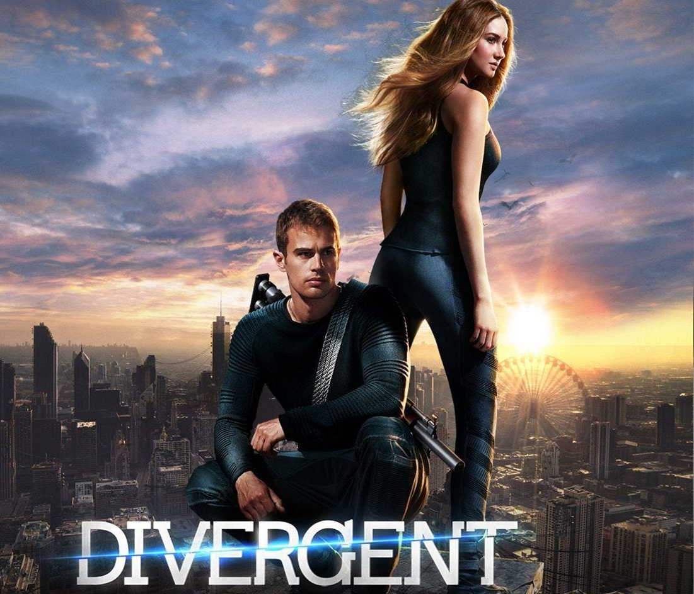
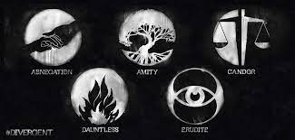
DIVERGENT
When science creates a dystopia
Divergent is a dystopian science fiction film based on the 2011 novel of the exact same name by Veronica Roth.
From her book, 3 films have been adapted: «Divergent» «Insurgent»and « Allegiant. »
The story takes place in a futur dystopian Chicago in the Northeast of what we used to call the United States of America. In the ruins of the ancient city the society is divided into 5 groups; factions « to keep the peace »: Abnegation, the selfless
Amity, the peacefuls
Candor, the honests
Dauntless, the braves
And Erudite, the intellectuals
The rest of the population is called the factionless, they are outcasts.

Slide 2
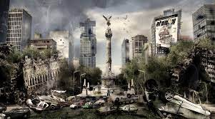
synopsis
Beatrice Prior was born into the selfless faction which is in charge of the government. On her 16 birthday, just like all the other children of her age she has to make a test which will reveals her best-suited faction. But the test went wrong, Tris isn’ t like everybody else. Her results ? Abnegation…but also Erudite and Dauntless. Impossible ? No; because Tris is a Divergent and she must keep that secret at all cost.
WHY IS DIVERGENT A DySTOPIA?
DEFINITION: Opposite of Utopia.
An imagined state or society in which there is great suffering or injustice, typically one that is totalitarian or post apocalyptic.
The divergent films obey to several rules characterizing the dystopia and I’m going to explain some of them to you.
First of all, we think that the society is a perfect utopian world but that’s just an illusion. Soon after, in the first mintutes of the film we can clearly see that the citizens have a fear of the outside world that s why they’ve built a wall to protect them. They live in a dehumanized society where factions are created to keep them under control. But this concept is woshipped by the people who conform to uniform expectations.
Second of all; the more we advance in the films the more we understand that citizens are perceived to be under constant surveillance and that independent thought, information and freedom are restricted. The Divergents are a threat for the government because they can think by themsleves and then rebelled against the factions system that’s why they’re hunted down by the Erudites.

Slide 3
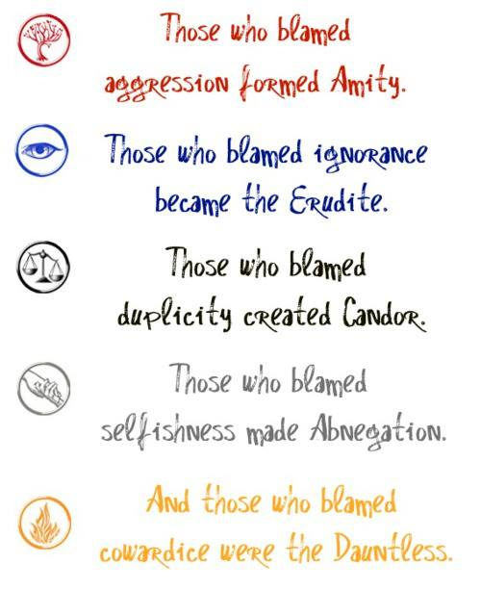
THE REAL DYSTOPIAN WORLD
A dystopia inside another
Divergent takes place in a corrutped world where science reigns and genetics splicing is causing people to go crazy and more. One day some scientists decided to modified people’s genes in order to make them: smarter, braver, selfless,more honest and more peaceful.But sadly the experiment failed and went wrong:
In order to correct those genes scientists started an experiement and in the big finale we finally understand that inside the fence is where Edith Prior’s experiment is. The only experiment that doesn’t failed thanks to the introduction of the faction system which brings back order and control. And then came the Divergent, the people whose genes had been corrected
In Divergent science is used to create a dystopian world. They took what was already real: the genetic modifications done on animals in certain labs and took it at the extrem. Modifing humans genes. The experiment failed and chaos reigned. Outside the fence the people were indeed almost all genetically damaged. That’s what created the « end of the world » and make a dystopia.
WHY DIVERGENT ?
I chose Divergent because I’ve read the books and loved the films. I love the complexity of the universe.This dystopia shows us the result of the control of the society by an authoritarian government. It is a dehumanized universe where science dominates social relations. I also love that the main character is a woman, it happens a lot in dystopian films and novels because in those universes a woman point of vue is preferred. It brings more hope and impress more because a woman rebelling is rarer and in those films they find courage and strength, and became leaders. Other action films preferred a male character because in the public opinion women can’t lead they’ll always be outsmarted and outmuscled but they’re wrong and having a female character is somehow a way to give a voice to the oppressed sex.

